Slide 1


FACE MASK DETECTION
CS 6220: Big Data Sys. & Analytics

Slide 2
TABLE OF CONTENTS
01
02
03
The Disease & Our Approach
What are we dealing with?
What are we trying to solve?
The Models
What approaches are we taking?
How do they perform?
Future Work
What do we have left?
What will be done by the end of the semester?
Athreya Anand

Slide 3
01
The Disease & Our Approach
Athreya Anand

Slide 4
01.1
The Disease
What are we dealing with?
Athreya Anand

Slide 5
ABOUT COVID19
Spotted
Affected
Vaccine
Prevention
December, 2019
1.26M Deaths
50.5M Cases
Although promising,
still will take months
Prevention is currently the best way to hinder
Athreya Anand

Slide 6
Highly Infectious
Transmission
02
Pandemic
01
How do we prevent it?
03
Close contact through respiratory droplets
WHO classification due to contagiousness
Athreya Anand

Slide 7
MASKS
Athreya Anand

Slide 8
Benefits of Wearing a Mask
Flatten the Curve!
Small Businesses
“Normal” Life
Decrease the rate of infection
Allow small businesses to function to a degree
The safest way to do “normal” activities
Athreya Anand

Slide 9
01.2
Our Approach
What are we going to do?
Athreya Anand

Slide 10
“If 95% of the U.S. population began wearing masks, the expected death toll would drop by 50%.”
—Institute for Health Metrics and Evaluation
Jipeng Chen
Notes:
Jipeng Chen

Slide 11
This project is intended to….
identify an efficient means to identify proper mask-wearing such that it can be implemented effectively into real-world institutions.
Jipeng Chen
Notes:
Jipeng Chen

Slide 12
The Dataset
Kaggle Face Mask Detection Dataset https://www.kaggle.com/andrewmvd/face-mask-detection
853 images belonging to 3 classes
With_mask, mask_weared_incorrect, without_mask
Total Size: 388 MB
MaskedFace-Net Dataset https://github.com/cabani/MaskedFace-Net
Over 60,000 images of correctly worn masks
Over 60,000 images of incorrectly worn masks over chin or mouth-only
Computer-generated
Self-Collected Dataset
86 images of volunteers (ie., friends) with hands covering face with hands or shirt
Jipeng Chen
Notes:
Jipeng Chen

Slide 13
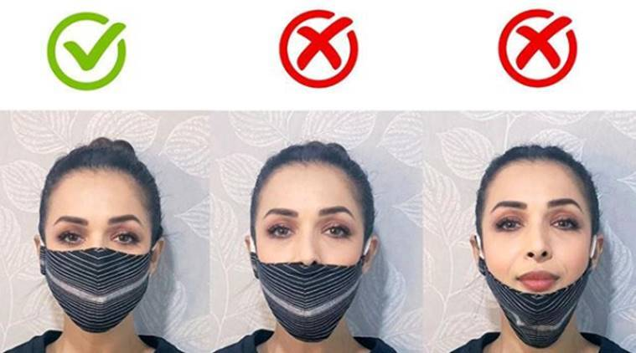
Incorrectly Worn Face Masks - Motivation
Want to detect instances where a face mask is improperly worn
Masks are effective only when completely covering mouth and nose
Properly worn face masks are key to public health!
Photo Source: malaikaaroraofficial/Instagram
Tianyi Liu

Slide 14
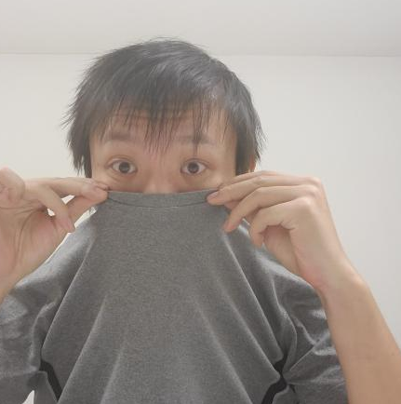
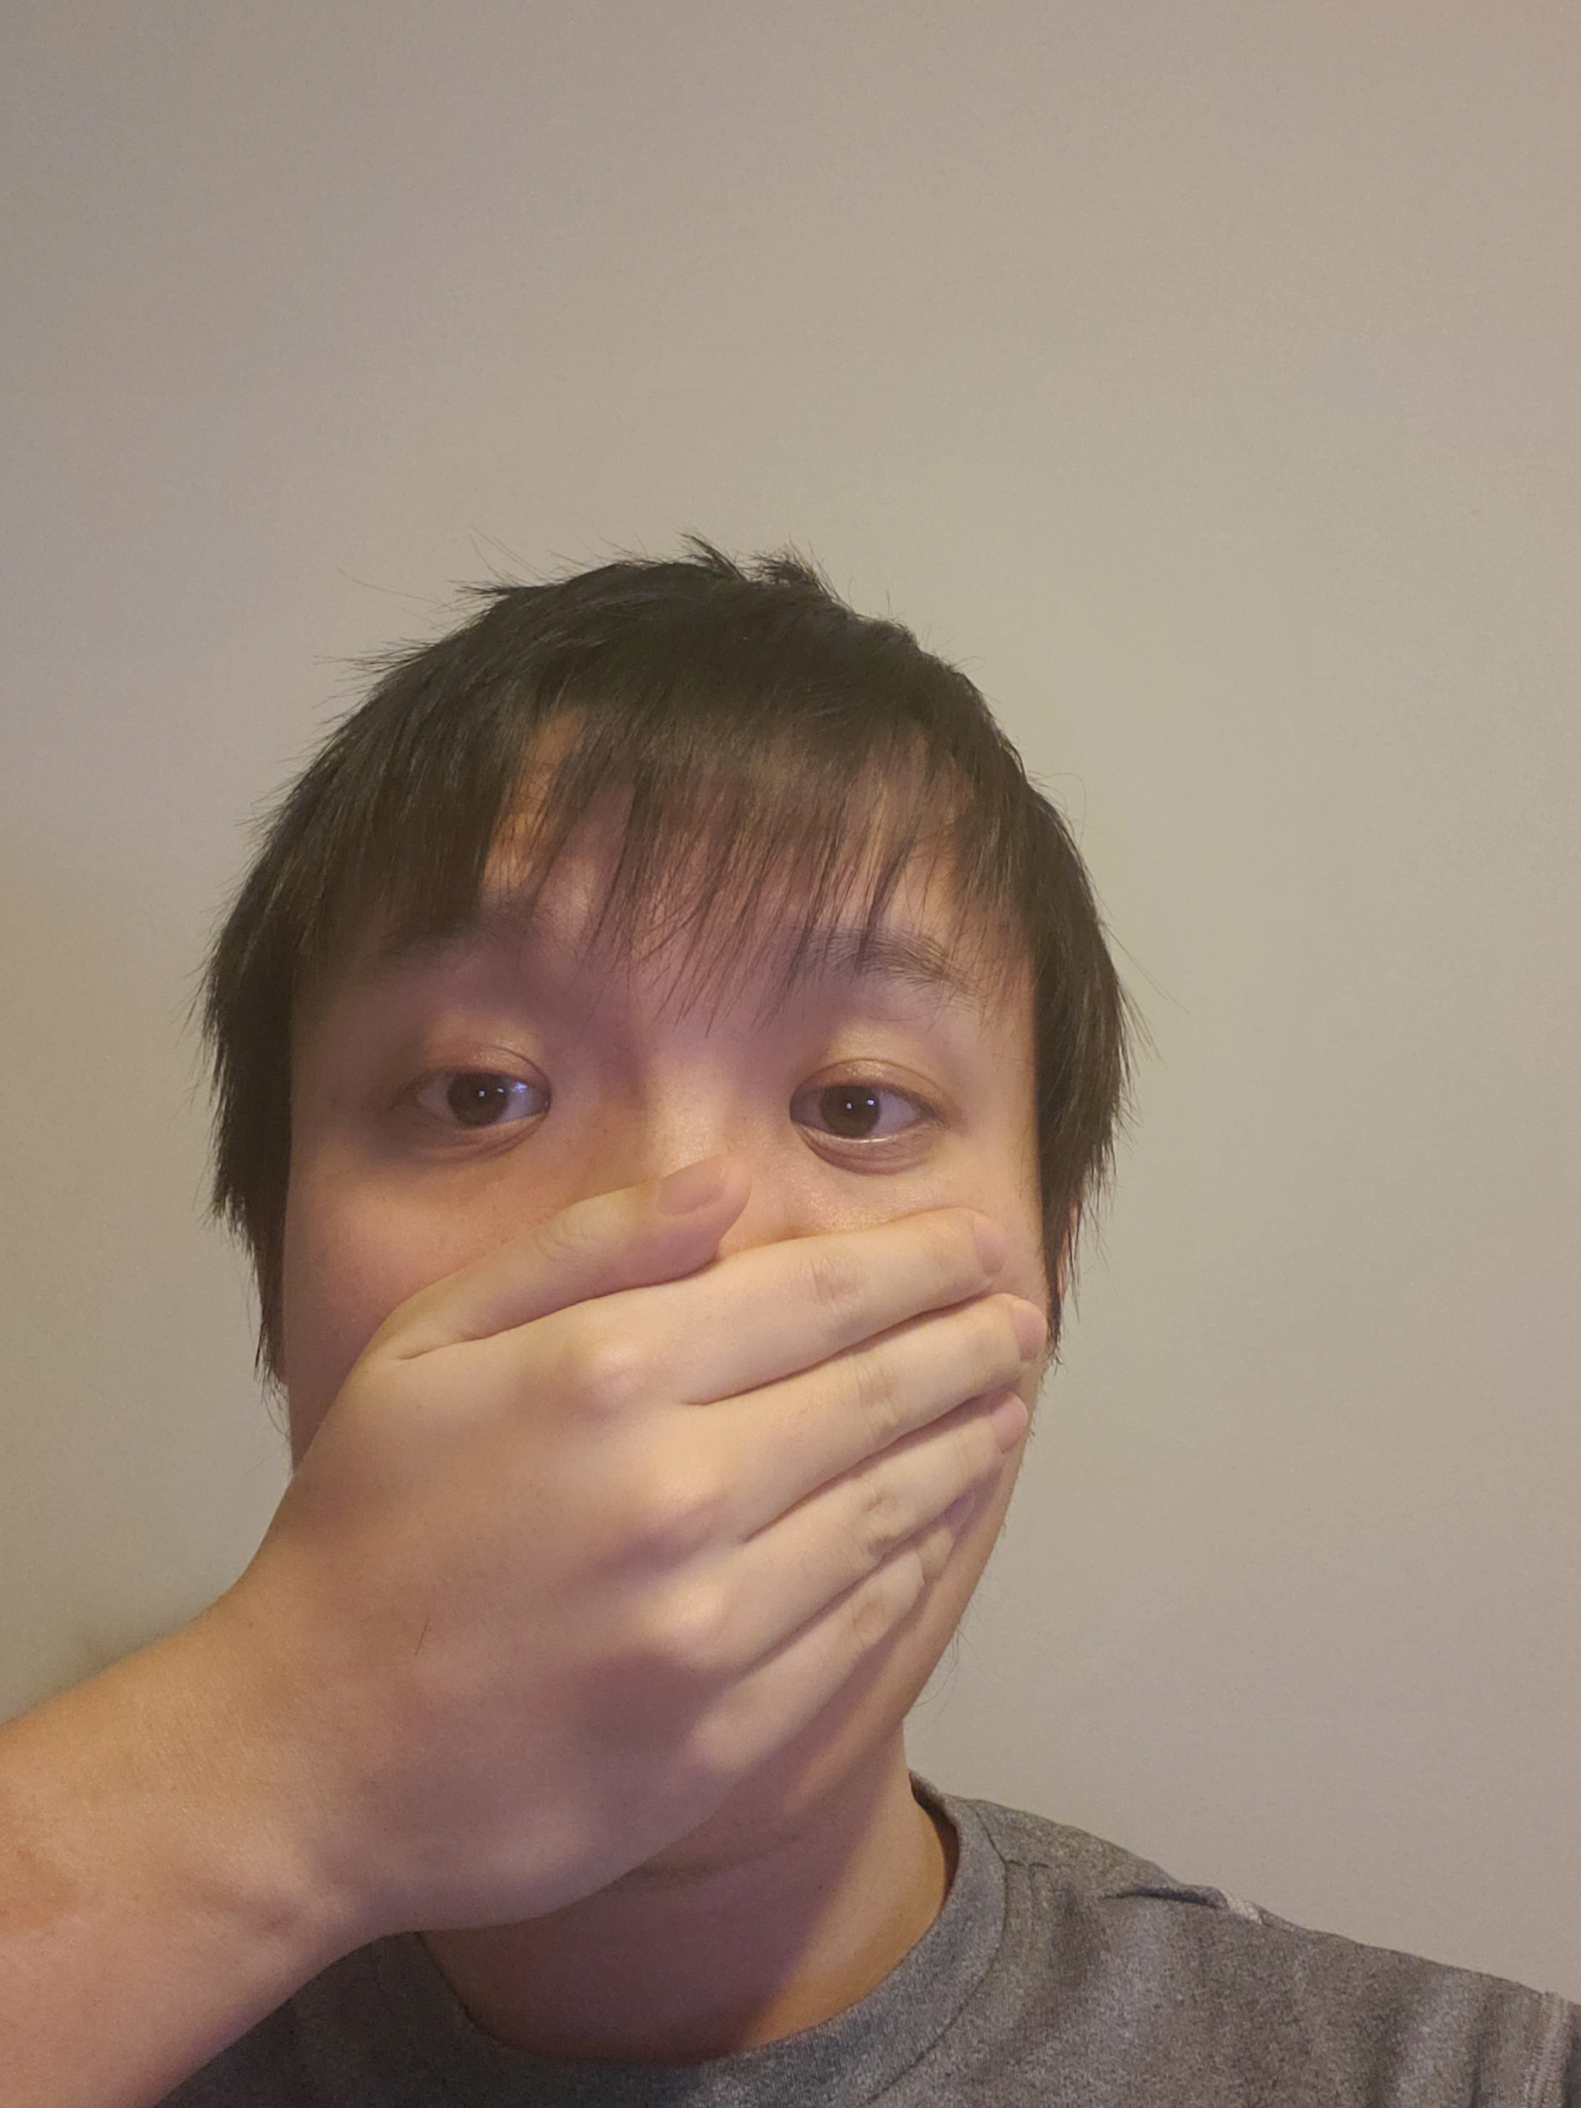
Incorrectly Worn Face Masks - Motivation
Potential Malicious Users
Some companies, such as Uber, are requiring users to complete a face scan to comply with new mask-wearing requirements
Malicious users can potentially circumvent algorithm that only checks that mouth and nose are covered
Want to create algorithm robust against easy attacks that could potentially defeat a generic algorithm
Tianyi Liu

Slide 15
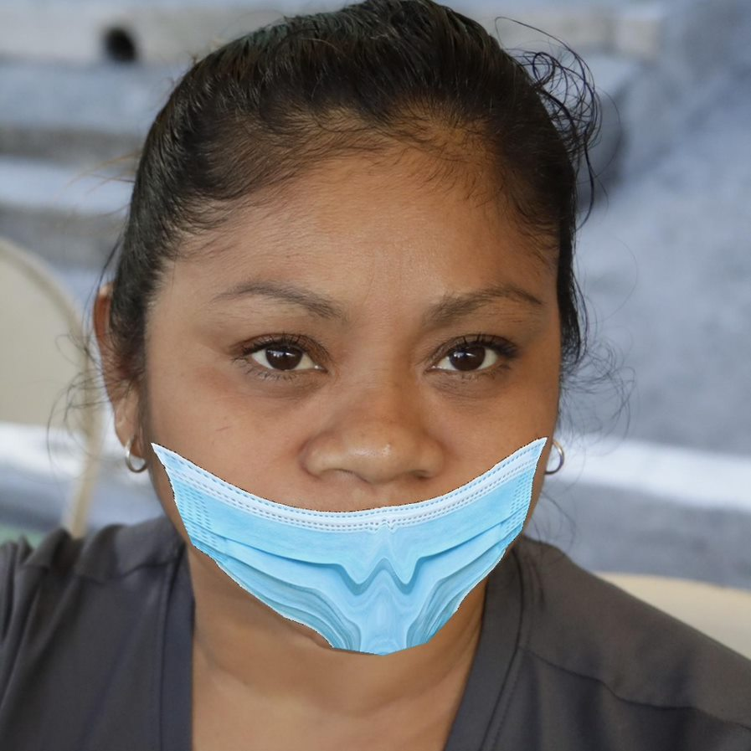
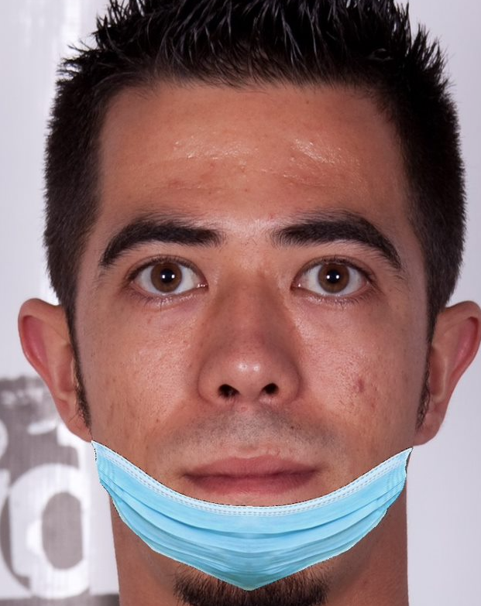
Incorrectly Worn Face Masks - Additional Datasets
MaskedFace-Net Dataset
https://github.com/cabani/MaskedFace-Net
Over 60,000 images of correctly worn masks
Over 60,000 images of incorrectly worn masks over chin or mouth-only
Computer-generated
Self-Collected Dataset
86 images of volunteers (ie., friends)
covering face with hands or shirt
Tianyi Liu

Slide 16
The Models
Faster RCNN
SSD
Using a faster version of R-CNN, predict and classify masks as bounding boxes
Object Detection Using Single Shot Detector
Divyanshu Upreti

Slide 17
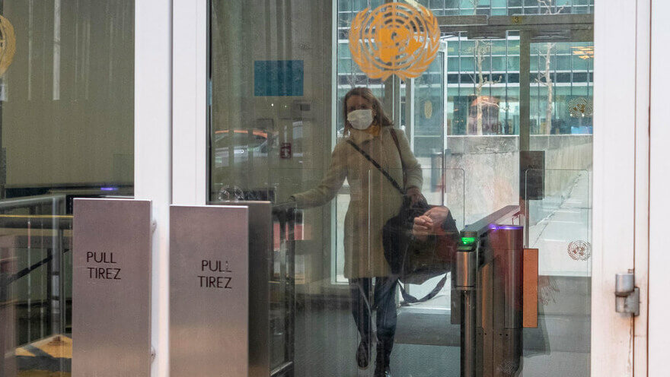
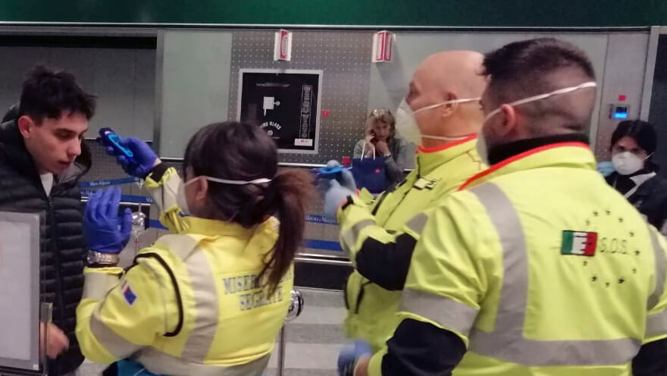
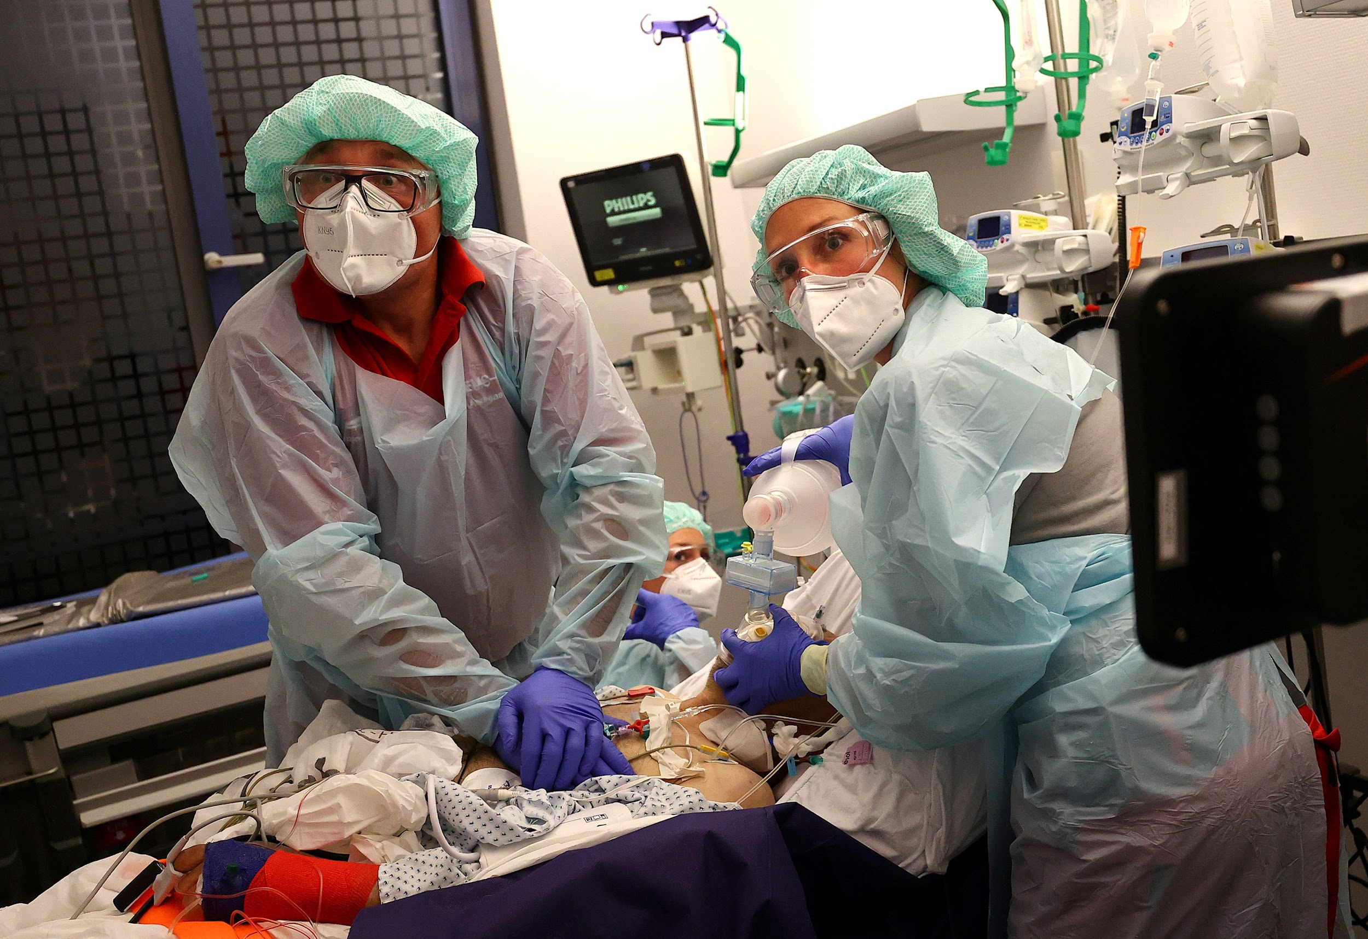
Potential Application
In many public areas like airport, hospital, office
Jipeng Chen
Notes:
Jipeng Chen

Slide 18
02
The Models

Slide 19
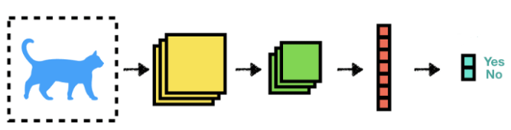
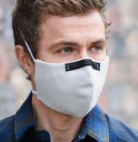
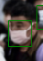
Training Process
Split Training / Test Datasets
Set hyperparameters
Run Through CNN Layers
Predictions
Validation
Training Set
Compare w/ Ground Truth + Compute Loss (Cross Entropy)
Backpropagation

Slide 20
02.1
Faster RCNN
Divyanshu Upreti

Slide 21
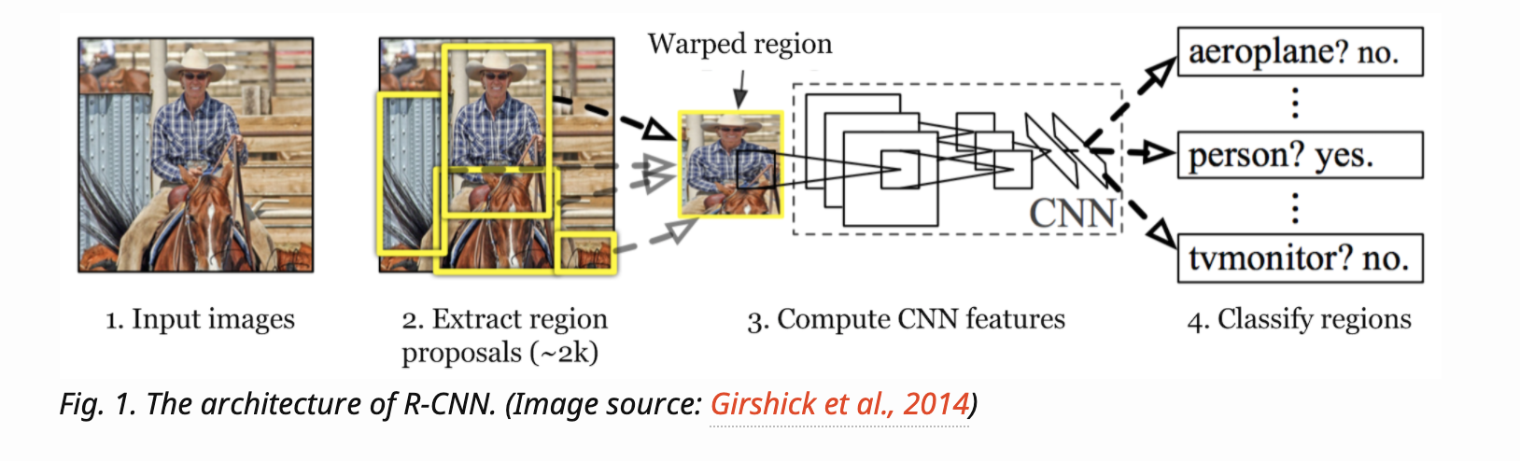
R-CNN
Region-based Convolutional Neural Networks
Two Steps:
Identifies Region of Interests
Extracts CNN features from each region independently for classification
Divyanshu Upreti

Slide 22
Fast & Faster RCNN
Fast RCNN unifies these 3 computations into one:
CNN for image classification and feature extraction
Top SVM classifier for identifying target objects
Regression model for tightening region bounding boxes
Fast R-CNN is much faster but region proposals are still generated separately by another model.
Faster R-CNN constructs a single, unified model composed of RPN (region proposal network) and fast R-CNN with shared convolutional feature layers.
Divyanshu Upreti

Slide 23
Faster RCNN Model
The dataset was divided into 90% training data and 10% test data.
The Pytorch framework was used.
A Faster RCNN Resnet50 instance segmentation model pre-trained on COCO was used.
The model was fine tuned on the training dataset.
We use Stochastic Gradient Descent as the optimizer
The loss function is the sum of RPN(Region Proposal Network) and the region classification loss.
Divyanshu Upreti

Slide 24
Faster-RCNN Results
Accuracy | 58.33%
Recall | 60%
Precision | 85.71%
Avg Prediction Time | 15.24 ms
Divyanshu Upreti

Slide 25
Bounding Box Labels
Label | Bounding Box Color
Mask Worn Correctly | Green
Mask Worn Incorrectly | Yellow
Mask Not Worn | Blue
Divyanshu Upreti

Slide 26
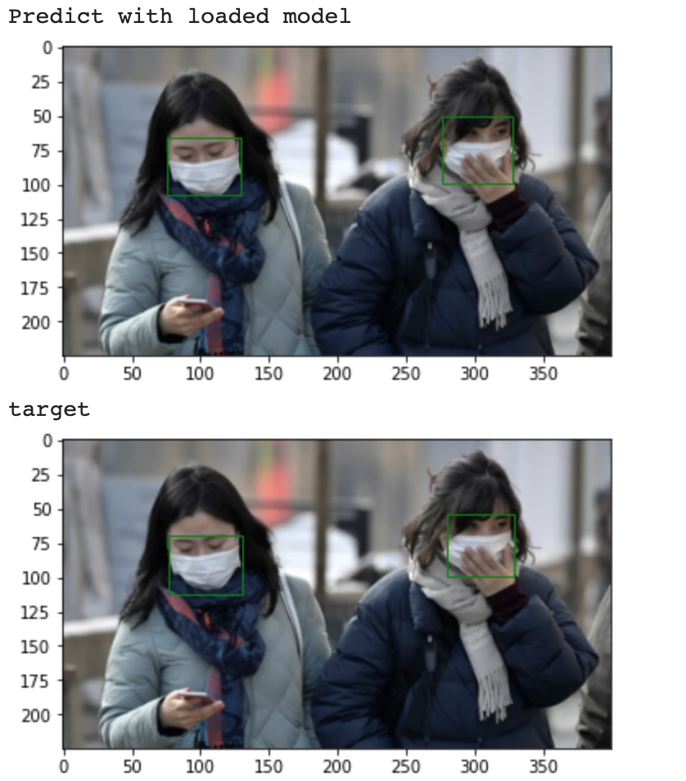
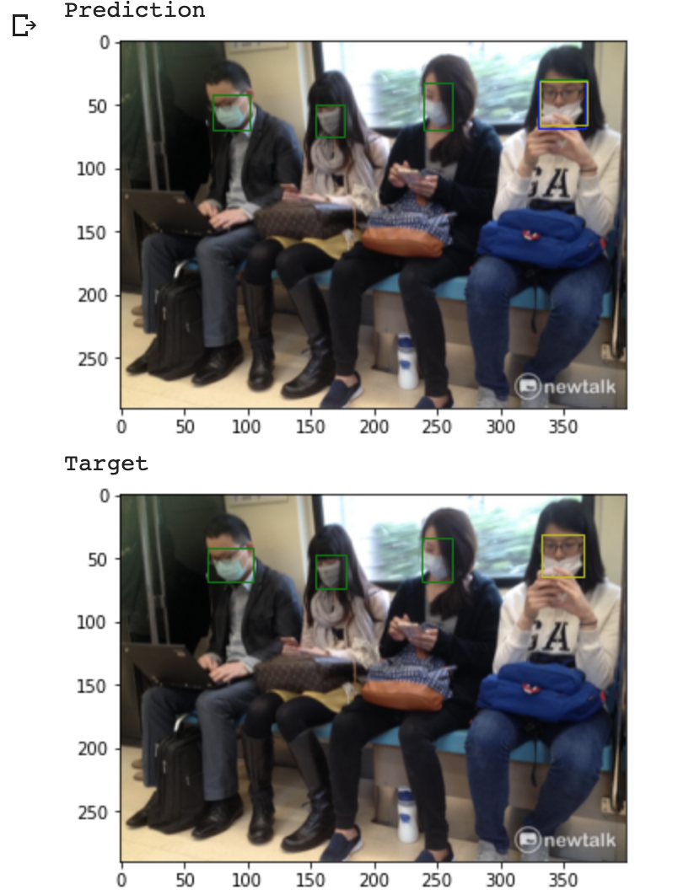
Easy Cases
Divyanshu Upreti

Slide 27
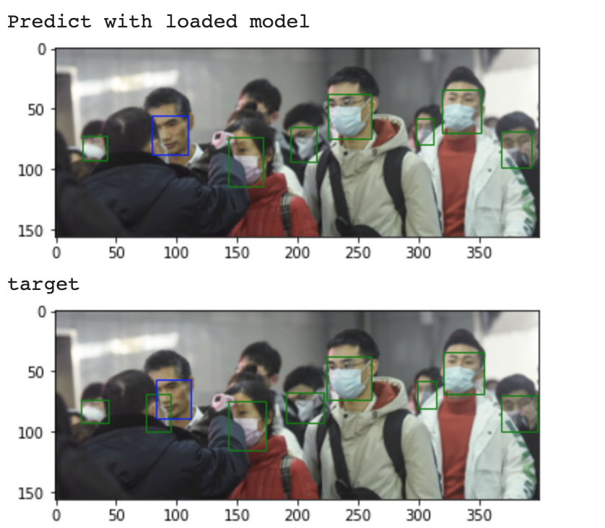
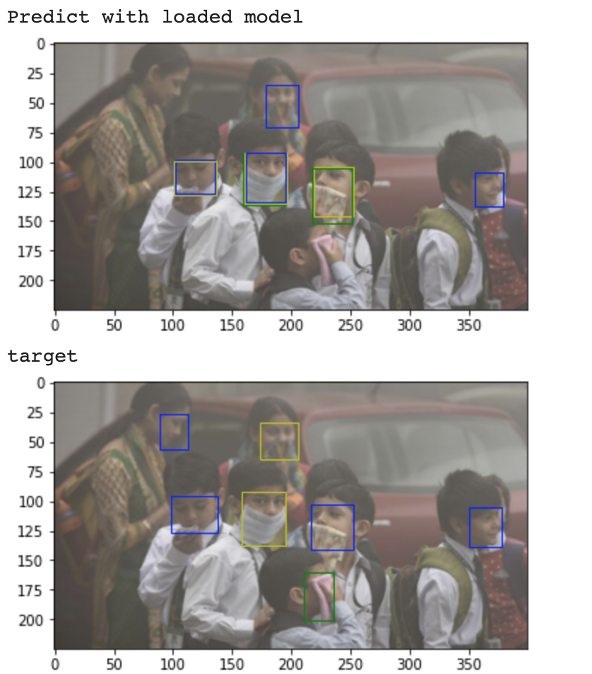
Edge Cases
Divyanshu Upreti

Slide 28
Future Improvements
Improve the prediction on edge cases
Improve prediction for incorrectly worn masks
Get more data
Test the model on real time images from a camera
Divyanshu Upreti

Slide 29
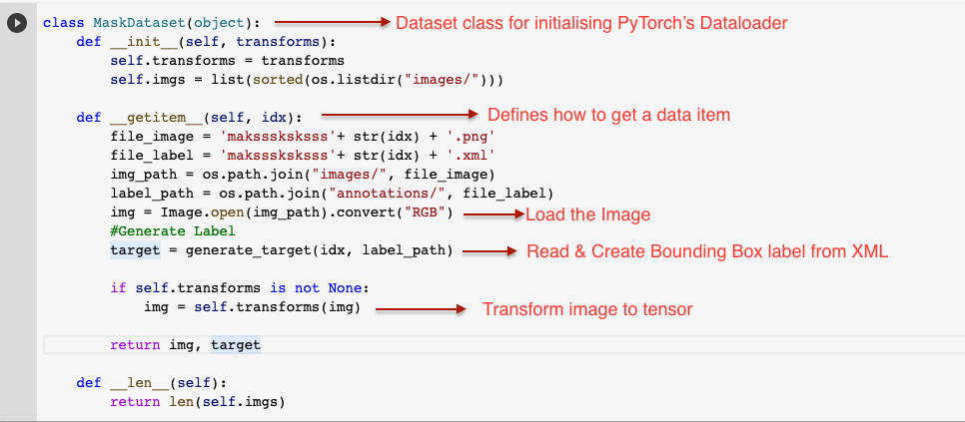
Code WalkThrough- Input
Divyanshu Upreti
Notes:
One method called getitem that define how to get the datapoint at the time of training and testing.
Here we also make sure that we trasnform the image and the label to tensors

Slide 30
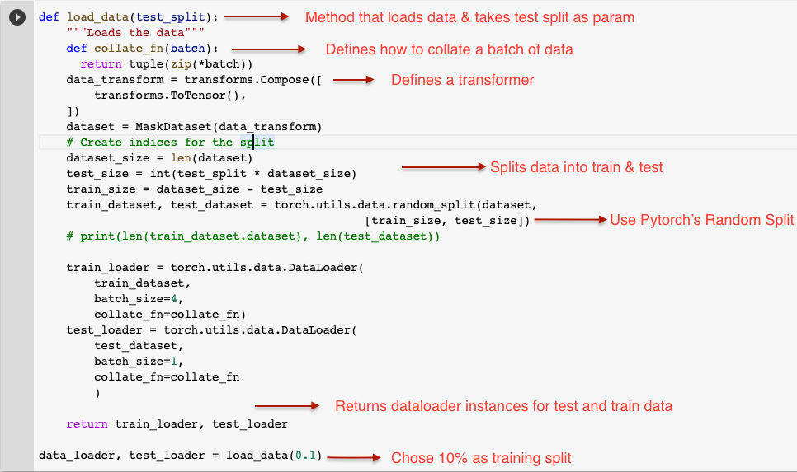
Code WalkThrough- Input
Divyanshu Upreti
Notes:
method that actually loads the data
defines a transformer, that converts data to tensors
uses pytorch random_split util to randomly divide training and testing data into two fractions
returns objects which can be iterated over to get the corresponding training and testing data
finally is called, specifying 10% as testing split

Slide 31
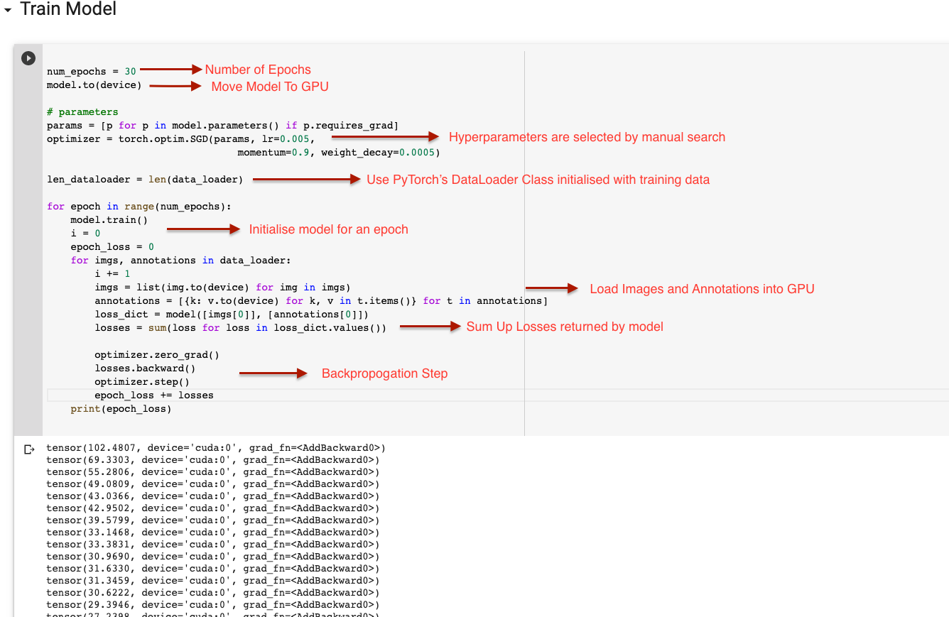
Code Walkthrough-Model Training
Divyanshu Upreti
Notes:
model training
we in total 30 epochs
select hp through manual search where we manually change hp untill we ge optimal results
in each spoch iteration we sum up the total loss which we decreases over subsequent epochs

Slide 32
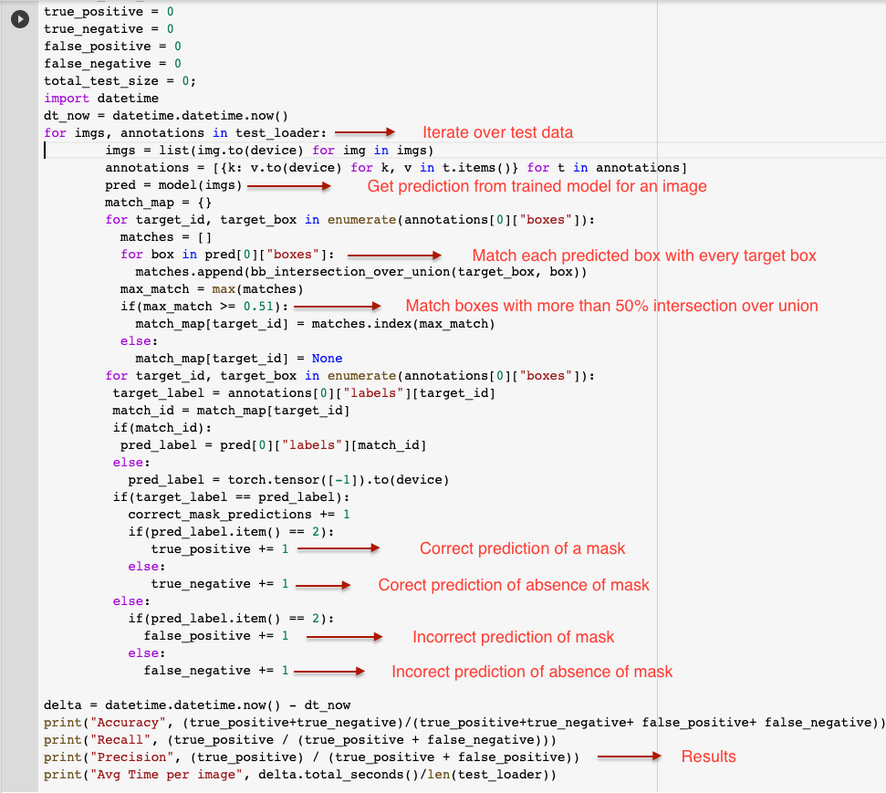
Code WalkThrough-Testing
Divyanshu Upreti
Notes:
testing module
we initialize true positive, negatives and other variables
iterate over test data one image at a time and get prediction. each predicted bounding box is compared with all target bounding boxes and the one with more than 50% intersection over union is selected for comparison. This bb label is then compared to target label to classify the test point as true positive…
Finally accuracy, recall, precision and prediction time are calulcated using well know formalues

Slide 33
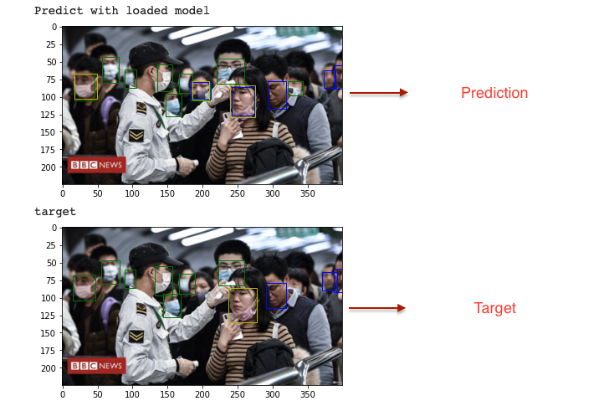
Code WalkThrough- Output
Divyanshu Upreti

Slide 34
02.2
SSD
Arnav Jeurkar

Slide 35
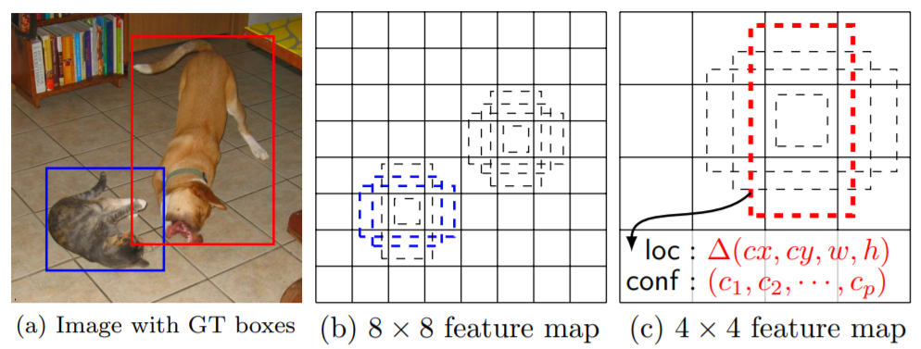
SSD
Single Shot Multibox Detector
SSD requirements:
An input image and ground truth boxes for each object during training
During training time, we match these default boxes to the ground truth boxes
Arnav Jeurkar

Slide 36
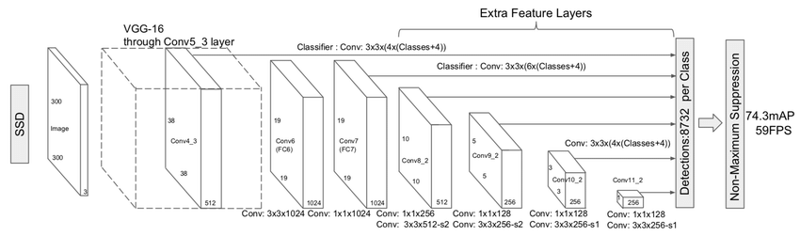
SSD Architecture
Inspired from the VGG-16 architecture
However, it discards the fully connected layers
Instead a set of auxiliary convolutional layers (from conv6 onwards) are added
For Multibox, the work done on an Inception-style convolutional network is used
Arnav Jeurkar

Slide 37
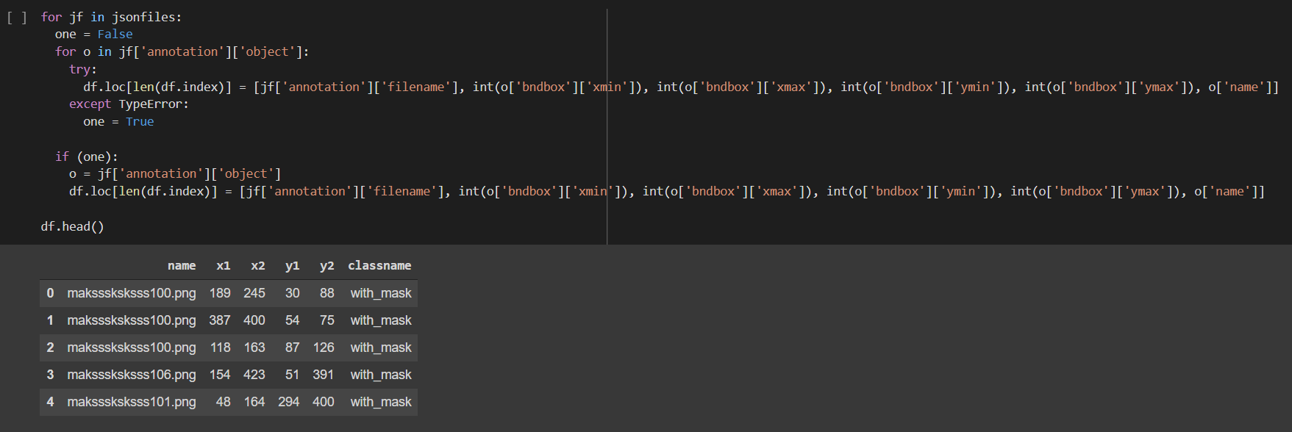
Code Walkthrough: Reading data

Slide 38
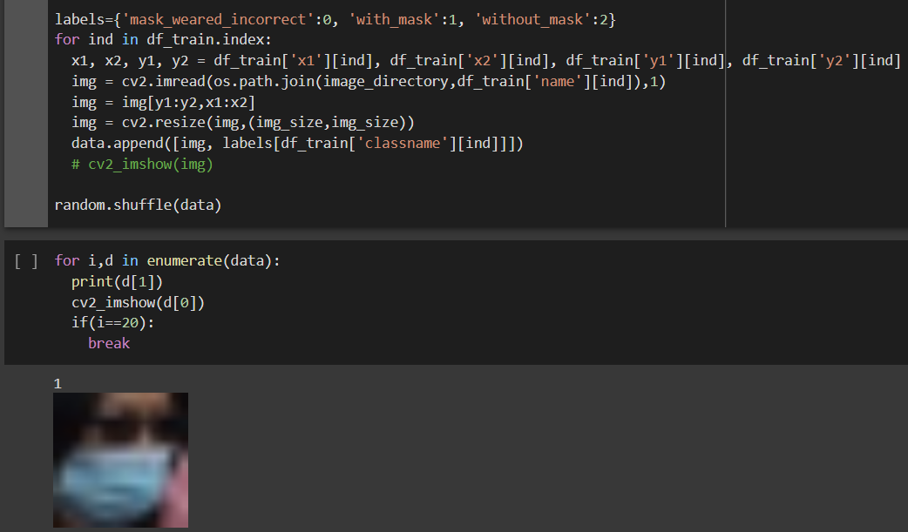
Code Walkthrough: Visualizing data

Slide 39
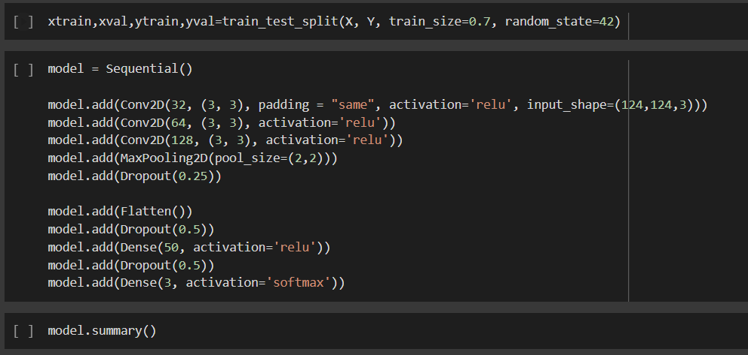
Code Walkthrough: Defining the model

Slide 40
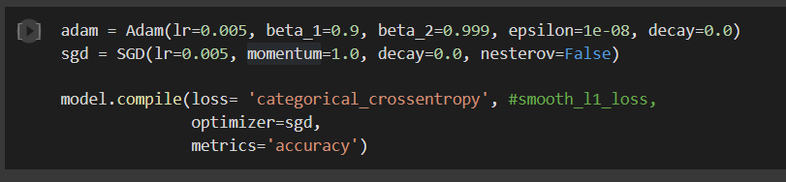
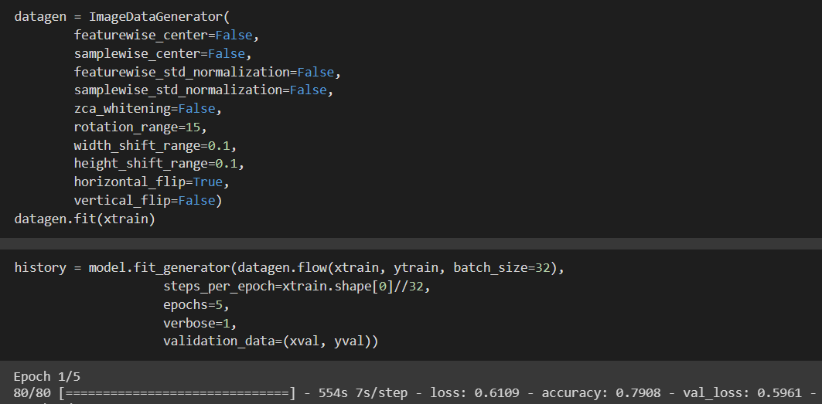
Code Walkthrough: Training
Compile with Hyperparameter tuning
Fit the model

Slide 41
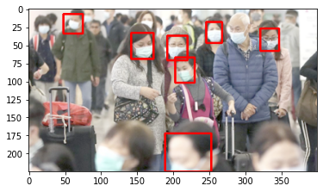
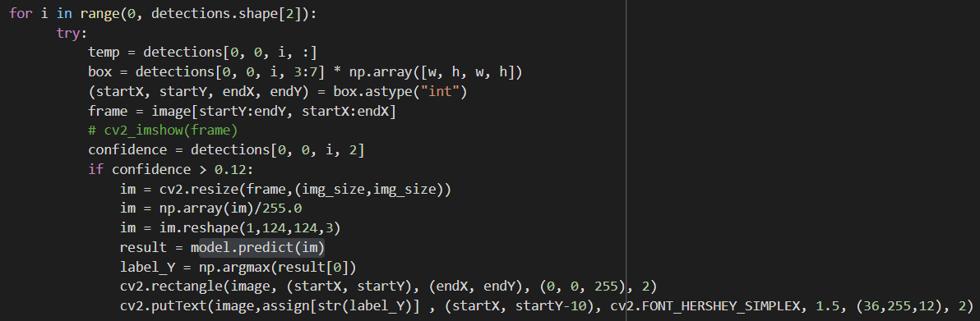
Code Walkthrough: Model at work

Slide 42
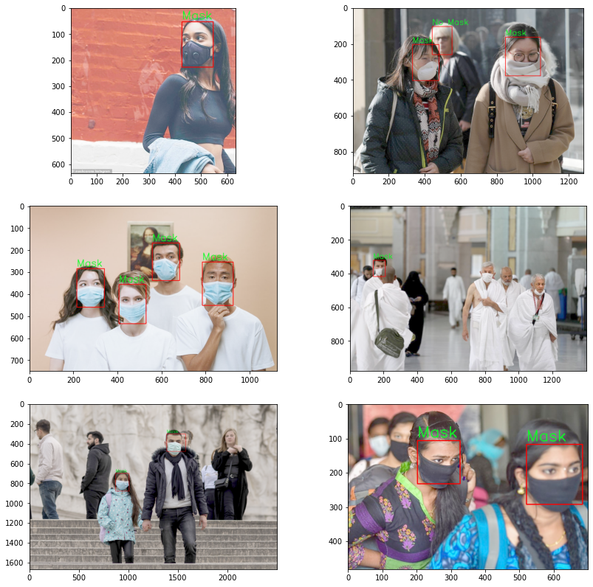
Easy Cases
These are some of the test images where we observed that the model did significantly better at recognizing the correct bounding box and category
Arnav Jeurkar

Slide 43
Incorrect Cases
Problems with:
People walking in the background
Incorrectly worn masks
Arnav Jeurkar

Slide 44
Future Improvements
Improve the prediction on edge cases
Take into consideration the orientation of the person
Improve prediction for incorrectly worn masks
Try using face detection and then running a classifier
Hyperparameter tuning
Test the model on real time images from a camera
Arnav Jeurkar

Slide 45
02.3
YOLO
Jipeng Chen

Slide 46
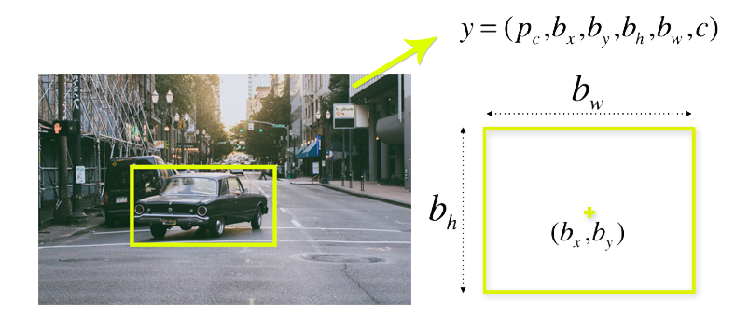
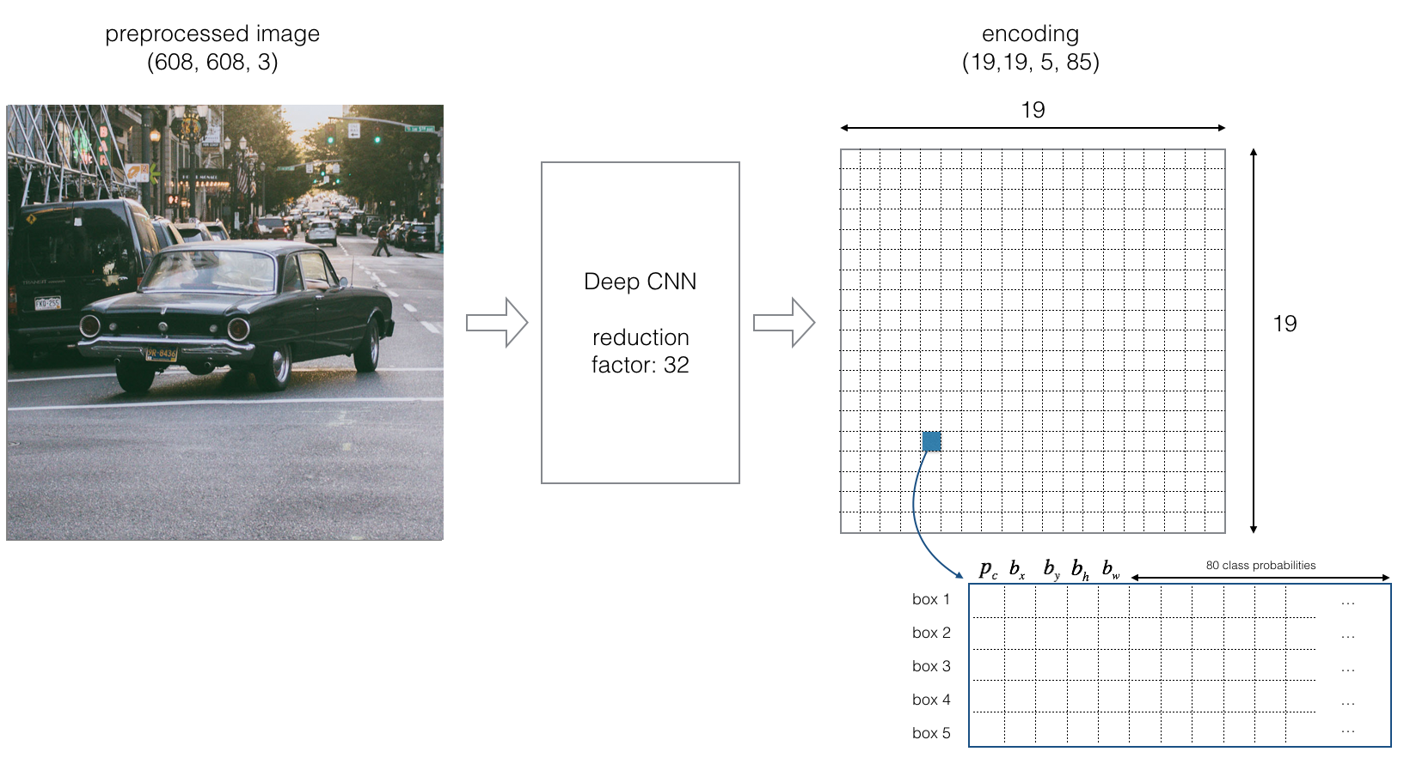
YOLO (You Only Look Once)
You only look once (YOLO) is a state-of-the-art, real-time object detection system.
Three Steps:
The framework then divides the input image into grids
Image classification and localization are applied on each grid. YOLO then predicts the bounding boxes and their corresponding class probabilities for objects
Jipeng Chen

Slide 47
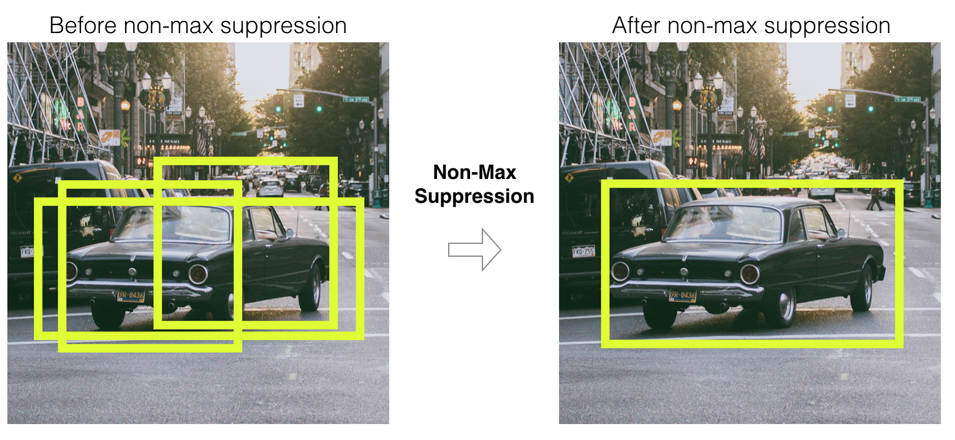
YOLO (You Only Look Once)
(continued) Most of these cells and bounding boxes will not contain an object. Therefore, we predict the value pc, which serves to remove boxes with low object probability and bounding boxes with the highest shared area in a process called non-max suppression.
Jipeng Chen

Slide 48
YOLO Model
The dataset was divided into 80% training data and 20% test data.
The Pytorch framework was used.
A YOLOv5s model pre-trained on COCO was used.
The model was fine tuned on the training dataset.
We use Stochastic Gradient Descent as the optimizer
The loss function is the sum of RPN(Region Proposal Network) and the region classification loss.
Jipeng Chen

Slide 49
YOLO Results
Accuracy | 66.85 %
Recall | 68.74 %
Precision | 49.9 %
Avg Prediction Time | 1308 ms
Jipeng Chen

Slide 50
Bounding Box Labels
Label | Bounding Box Color
Mask Worn Correctly | Blue
Mask Worn Incorrectly | Orange
Mask Not Worn | Green
Jipeng Chen

Slide 51
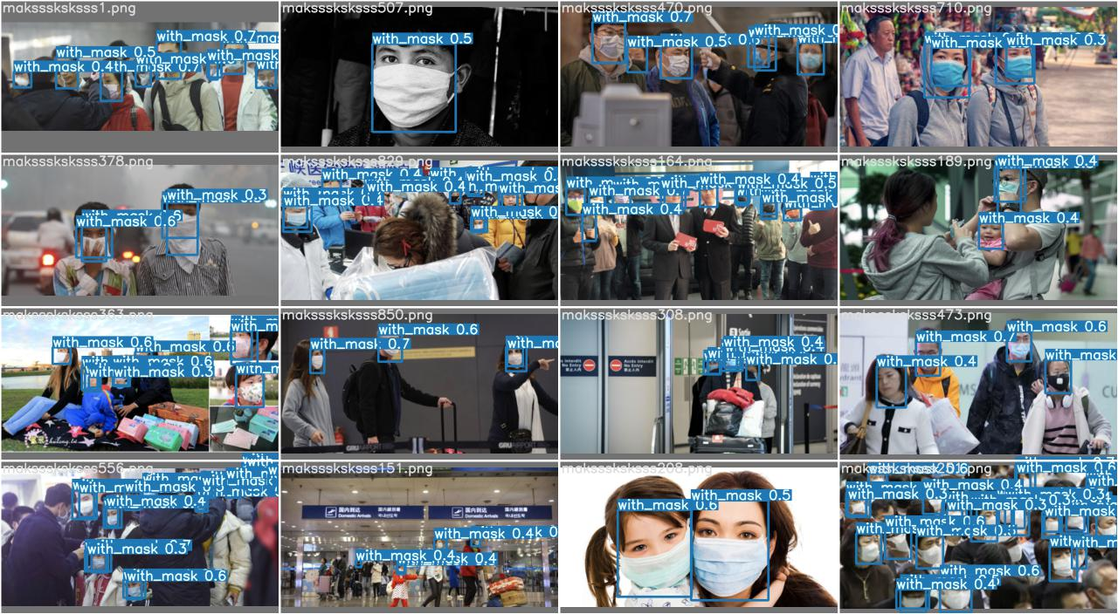
Easy Cases
Cases with a obvious mask facing to the camera in the center of the picture.
Jipeng Chen

Slide 52
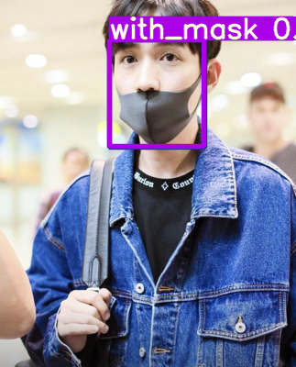
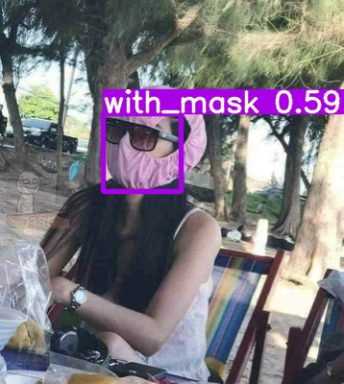
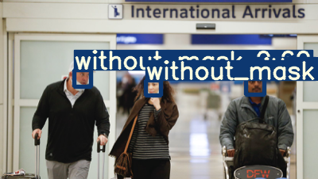
Good Cases and Edge cases
Good Cases
Someone wearing a mask-alike ‘mask’ regarded as mask
The alike thing is a good practice for its similarity to the mask, which can also cover the face and provide protection
Edge cases
Far and small faces with/without masks
Faces that are oblique, not facing directly to the camera
Similarity in color and shape which make the system recognize a larger ‘mask’ than usual
For example, a black mask with close color to the nose holes make that it looks like that the mask is correctly wore
This can be improved by feeding more data of edges cases, improving the quality of the images to eliminate the blurry
Jipeng Chen

Slide 53
Future Improvements
Improve the prediction on edge cases
Improve prediction for incorrectly worn masks
Get more data
Jipeng Chen

Slide 54
02.4
WEBCAM DETECTION
Athreya Anand
Notes:
Now that we have covered the models, let us look at an implementation for real time classification through your webcam

Slide 55
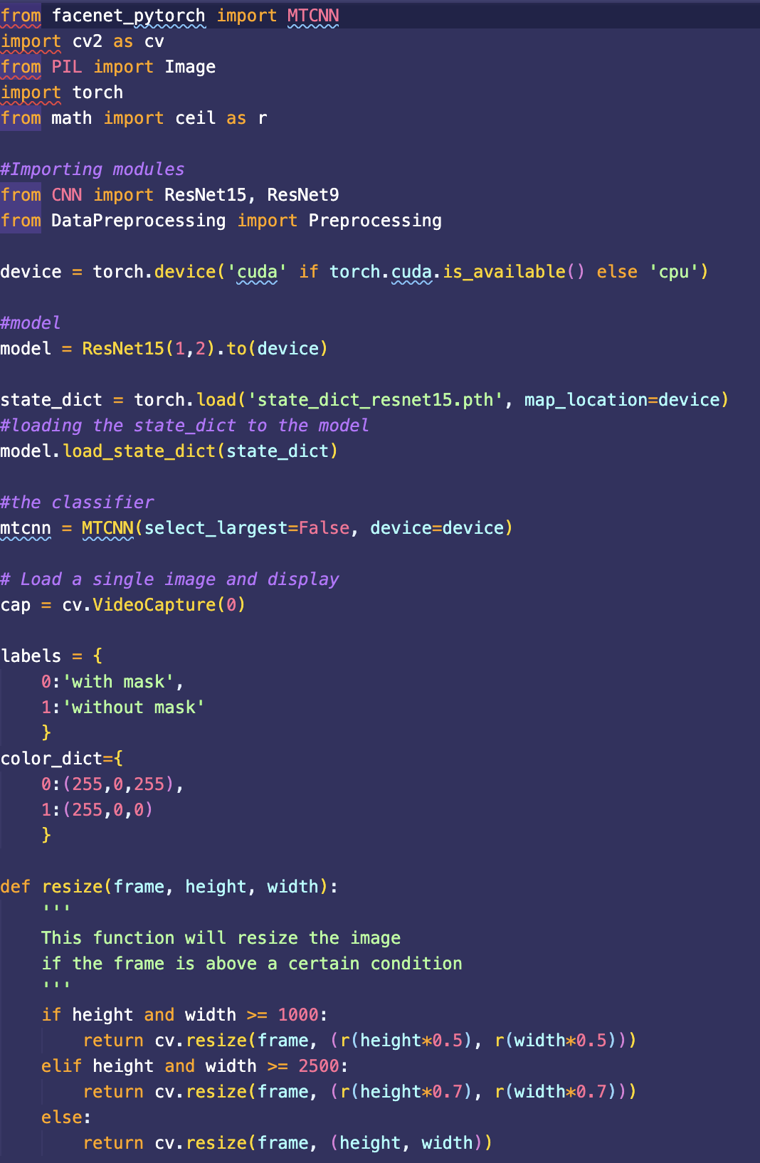
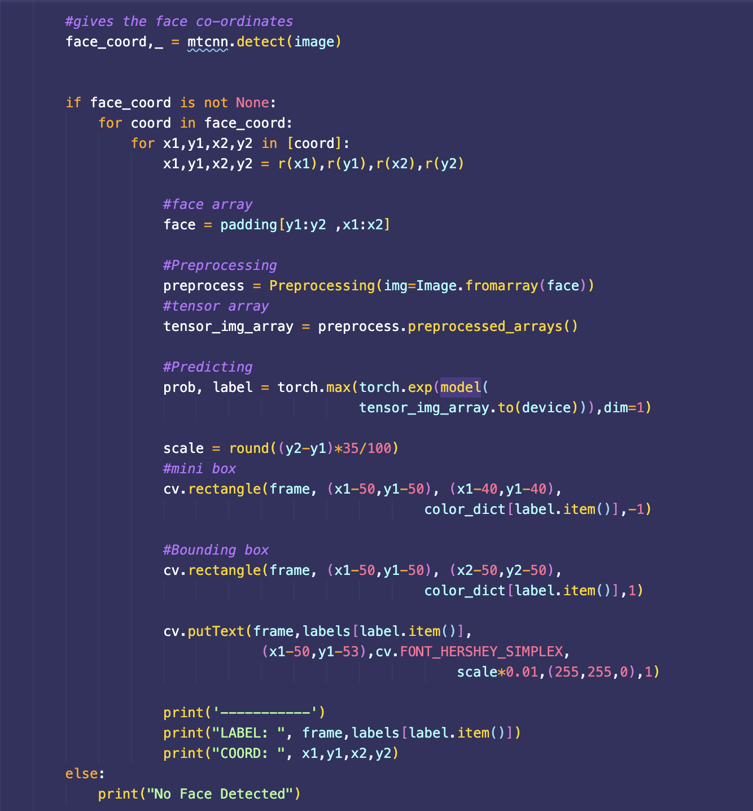
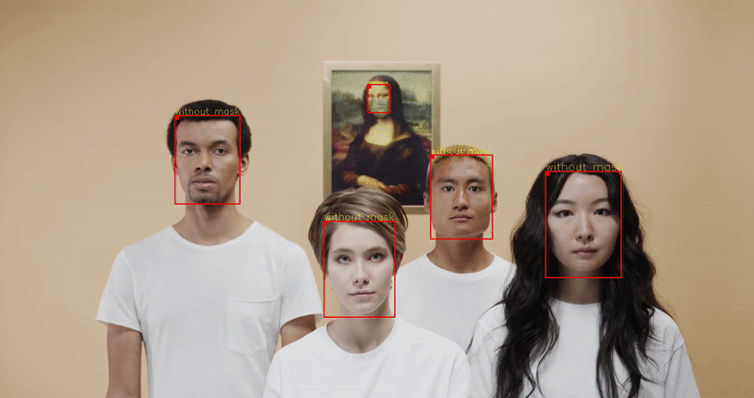
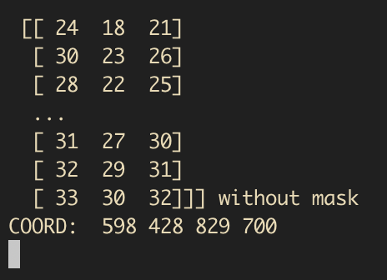
REAL TIME DETECTION
Athreya Anand
Notes:
This is a quick snapshot of the code used to implement the real time webcam detector. The left image shows some of the packages we use like pytorch and cv2. Next to it, the middle image under the title shows the logic of the software. We first use a pretrained model to find a face in the video as well as its corresponding bounding box. Once this is found, we preprocess and pass the frame to one of the models discussed before to provide a prediction. This prediction will then change the color and label of our bounding box accordingly. The screenshot on the bottom right showcases what a typical output looks like and the gif on top is an example video of how the software looks realtime. We can see that the label when I turned on my webcam is “without mask” and the bounding box is at coordinates 598 428 829 and 700. These coordinates represents where my face is and draws a box around it. This code is extremely flexible and can implement any of the three models mentioned above; the only thing we need is the pretrained weight file of each one. SImply plug in the model you desire and see the result!

Slide 56
Summary: Our Contributions
We took 3 pre-trained models: Faster-RCNN, SSD and YOLO
We trained and fine-tuned these models on the training data, to recognize proper mask detection.
Additionally wrote code to calculate accuracy, precision, recall for each model and compare.
We also implemented a real time webcam detector for masks that can potentially be used with any face detector algorithm - including the ones we trained!

Slide 57
03
Future Work & Takeaways
Athreya Anand

Slide 58
Comparison Between Faster-RCNN & SSD & YOLO
 | Faster-RCNN | SSD | YOLO (fully trained) | YOLO (trained in 2 hrs)
Accuracy | 58.33% | 56.2 % | 66.85 % | 11.7%
Recall | 60% | 58.5% | 68.74 % | 40.69%
Precision | 85.71% | 80.6% | 49.9 % | 27.28%
Avg Prediction Time | 15.24 ms | 13.39 ms | 1308 ms | 811.9ms
Jipeng Chen

Slide 59
Analysis on the Result
We can see that obviously, Faster-RCNN and SSD deliver a higher precision compared to YOLO, which are 85% and 80% compared to 49% of YOLO. The speed of them is also a highlight which can be as low as 15 ms and 13 ms, which is perfect for real-time system.
For YOLO, it take advantage in the metric Accuracy and Recall, which 66.85% qbe 68.74%, roughly 10% higher than the other two model. Unfortunately, its low speed of more than 1s on each image, which make it not suitable for a system with high requirement in the speed.
It is also interesting to compare the half-trained YOLO and fully trained YOLO, we can see that half-trained YOLO has gained a recall as high as 40%, which can be explained by the fact YOLO take more advantage in Recall.
Jipeng Chen

Slide 60
CONCLUSIONS
Conclusion 1
01
Conclusion 2
02
03
Go for faster-RCNN if you prefer precision.
Go for SSD if you prefer speed.
Conclusion
03
Go for YOLO if you prefer accuracy or recall of the system.
03
Jipeng Chen

Slide 61
Future Directions
01
03
Model 4
Final Report
Model 3
Live Detection
02
04
Explore a 4th model
Sum up our findings into a concise report
Explore a 3rd model
Implement live video face detection using the most promising model
Athreya Anand

Slide 62
THANK YOU!
questions?

